Slide 1
GIT tutorial
Wing Research Group
+ Iftach Addatives

Slide 2
Introduction
Learn why and how GIT aids software development
The outcome of this tutorial:
  Understand the design of GIT
  Be able to use GIT for everyday work

Slide 3
Terminology
Repository – The box where I put down my code
Pull / Push / Checkout – Take/Put/Check the files in the Repo
Branch – A separate part of my Repo
Merge – Merging branches
Conflict – Unmatching merged files
Commit – ‘Action’ done against the Repo
Revert – revert commits

Slide 4
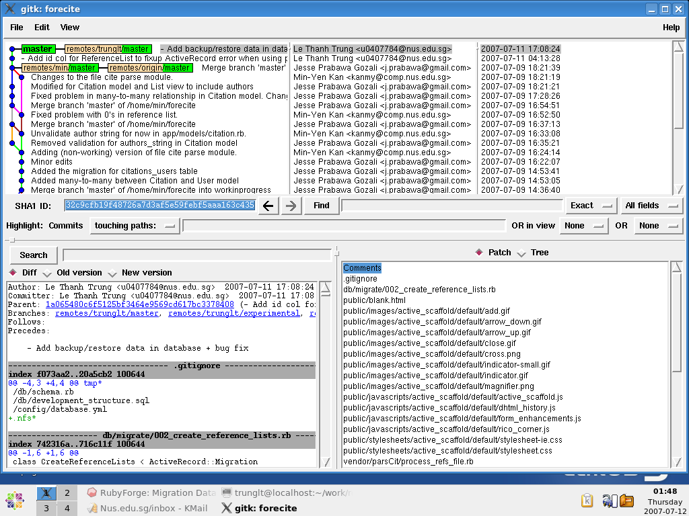

Slide 5
GIT background
Developed by Linus Torvald
Purpose: to facilitate Linux kernel development
Consider CVS/SVN as the evil

Slide 6
Git design objectives
Distributed
  No central repo
  Everyone is on his own island
  Write access class VS. Network of trust
Performance
  Branching and merge is cheap
  Diff the whole kernel tree in less than 1 second
  Store the KDE tree in less than 2GB while SVN takes 8GB

Slide 7
Everyday tasks with GIT
GIT has many routines:
  “git merge” - Join two or more development histories together
  “git pull” - Fetch from and merge with another repo or branch
  “git push” - Update repos with associated objects
  “gitk” – The git repo browser
  “git init” - Create a git repo
  “git config” - Get and set repo or global options

Slide 8
Everyday tasks with GIT
Introduce yourself to GIT
  “git config –global user.name “YourName””
  “git config –global user.email “YourEmail@something.com”
Create a repo
  “git init”
Clone a repo
  “git clone https://github.com/gitUserName/repoName.git”
  git clone
  Ssh: git@github.com:gitUserName/repoName.git

Slide 9
Everyday tasks with GIT
Create a branch:
  “git branch <name>”
  “git branch <name> <commit-id>”
Delete a branch:
  “git branch -d <name>”
List branch:
  “git branch”
  “git branch -r” //remote branch
Jump to a commit:
  “git checkout <commit-id>”
  “git checkout -b <name> <commit-id>”

Slide 10
Everyday tasks with GIT
Give remote repo a nicer name:
  “git remote add min ssh://<username>@aye.comp.nus.edu.sg/home/min/parcite”
Fetch changes from Min:
  “get fetch min”
Merge with the master branch of Min's repo:
  “get merge min/master”
Or in one shot: git pull min

Slide 11
Everyday tasks with GIT
Git commit and merge:
  Git has its own index database
  When you edit your repo, there are 3 things:
    HEAD: the reference in history that you are editing
    Cached: whatever you have just added and run git add
    Remains: files that you have not asked git to keep track on

Slide 12
Everyday tasks with GIT
Make a commit:
  After you edit some files,
  look at the output of “git status”
  ask GIT to keep track new files: “git add .”
  Added new files to the next commit
  “git commit –m ‘Commit-Name’ ”

Slide 13
Everyday tasks with GIT
Git merge:
  “git pull min” OR (“git fetch min” then “git merge min”)
  Conflicts
    $ git show :1:file.txt # the file in a common ancestor of both branches
    $ git show :2:file.txt # the version from HEAD, but including any
    # nonconflicting changes from MERGE_HEAD
    $ git show :3:file.txt # the version from MERGE_HEAD, but including any
    # nonconflicting changes from HEAD.
  Resolve the conflicts / reset and ask others to help

Slide 14
Everyday tasks with GIT
Reset the conflicted merge: use git-reset
“git reset –mixed <commit-id>
  Reset the index database to the moment before merging
“git reset –hard <commit-id>
  Reset the index database and the working data
“git reset –soft <commit-id>
  You made a commit and also made some typo mistake. This commands help us fix those errors without touching the working data and index database

Slide 15
Everyday tasks with GIT
“git reset” help you to revert the most recent commit only
Revert older commit by hiding is bad
Use “git revert” to introduce a patch to revert the merge/commit done.
This is left as an exercise

Slide 16
Everyday tasks with GIT
Last thing: how to ignore files in a repo:
  Use .gitignore: list files that you want to ignore
  Put .gitignore in the directory containing the files
  Example: Ruby on Rails project
  Example: C/C++ project

Slide 17
Question and Answer
Question and Answer :)

Slide 18
Summary
Git is a great tools for collaboration
New paradigm in SCM
Difficult to master, so learn it through everyday usage
Can always post questions to forum/admin group or :) Trung :)

